Slide 1
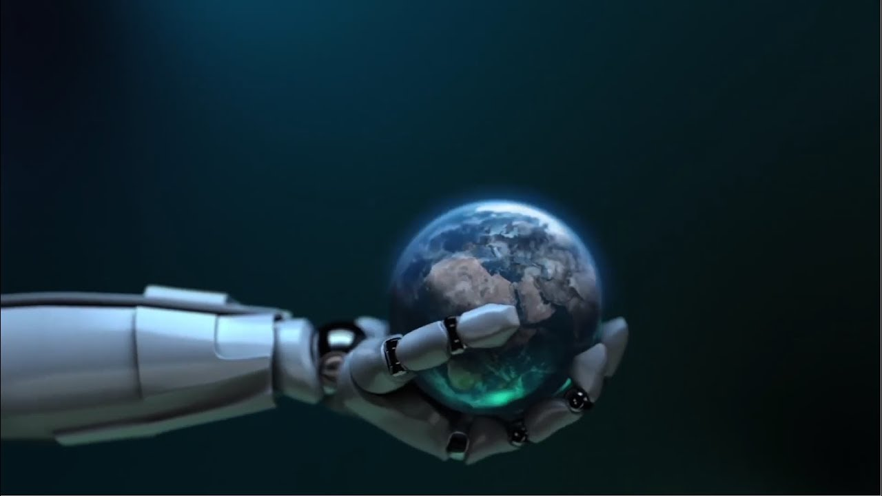
Special Topics in Computer Vision Domain

Slide 2
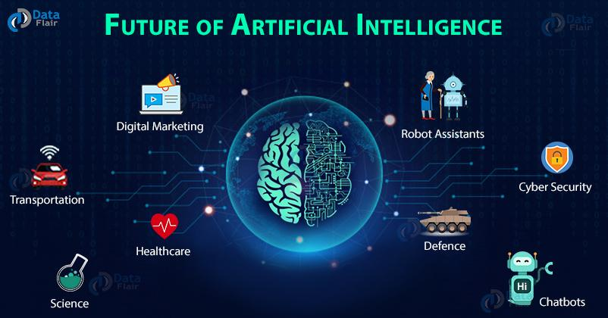
AI (Artificial Intelligence)
Predictions of AI robots in the future:
Agriculture and farming
Medical institutions
Industry automation
Transportation
Military wars
Economics
Bioinformatics
Education
Musical production
Entertainment
Politics
Physical sports
And many more...

Slide 3
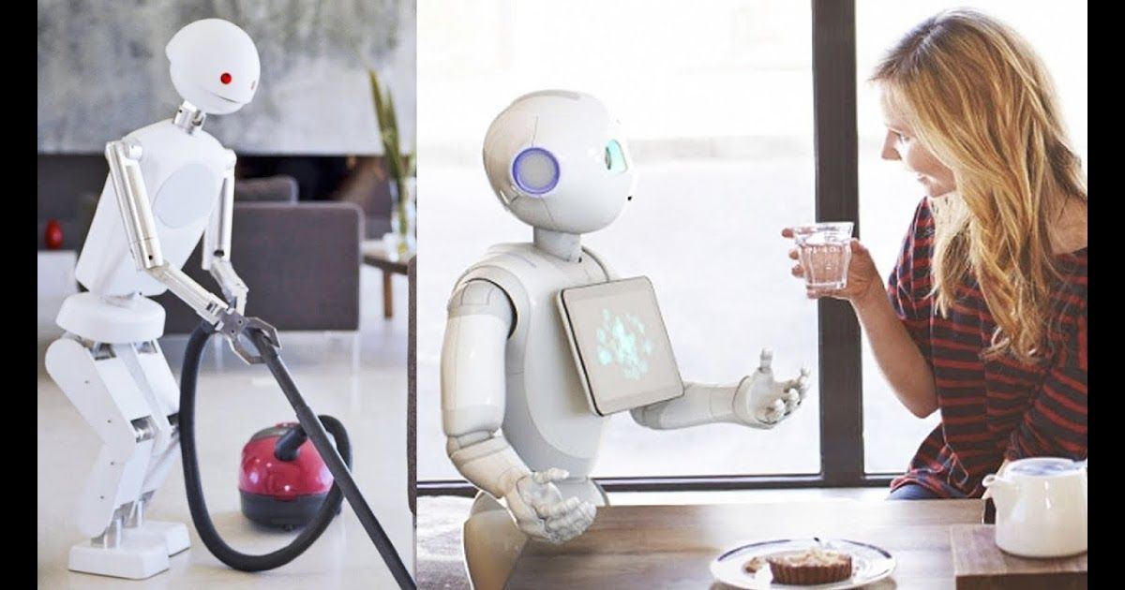
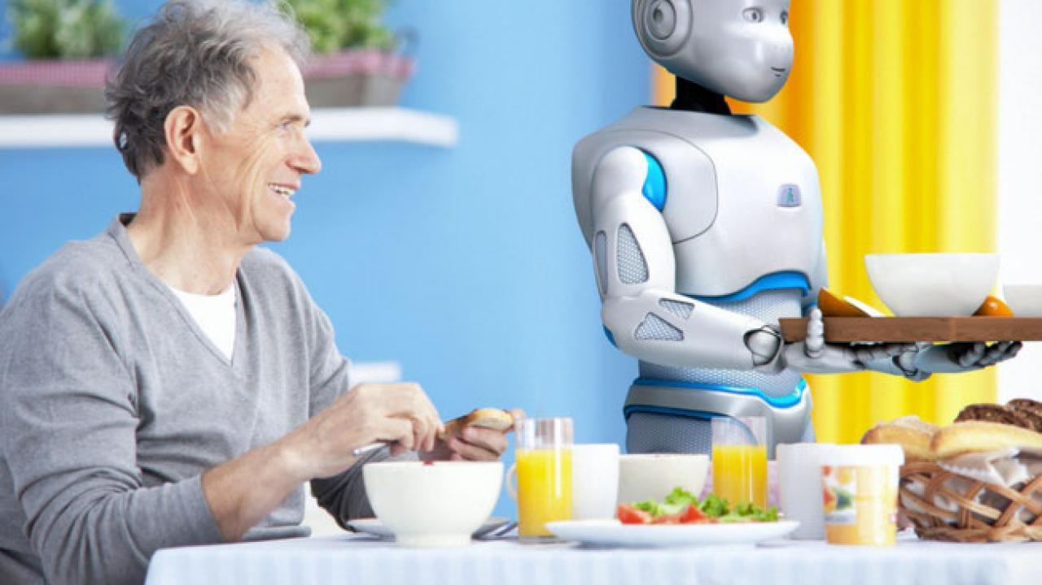
Personal Robots in future
Like personal computers that help us with our studies and work, there will be personal robots to help with our physical activities like cooking and cleaning

Slide 4
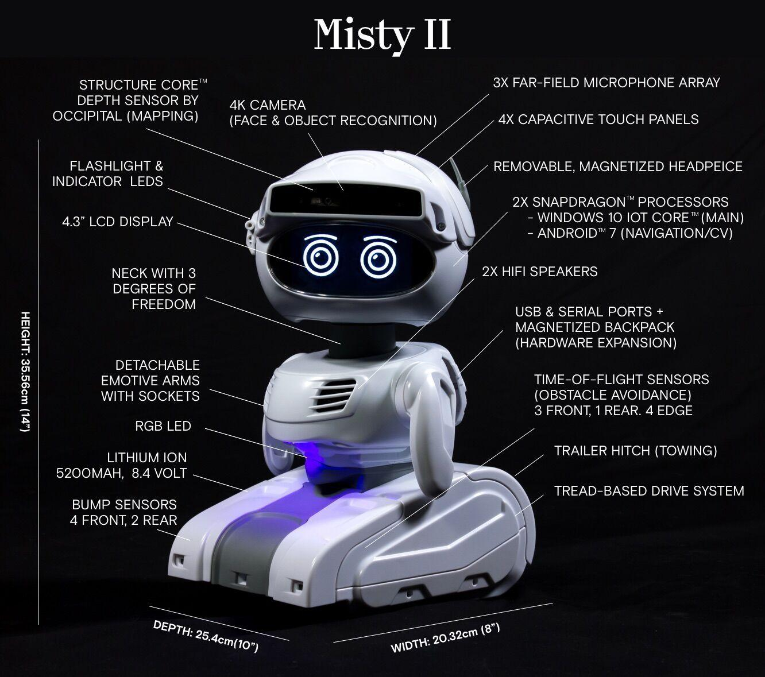
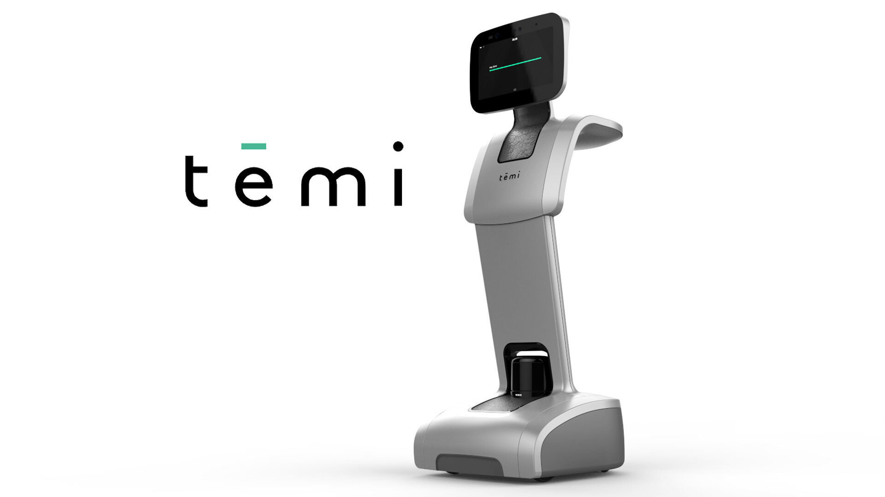
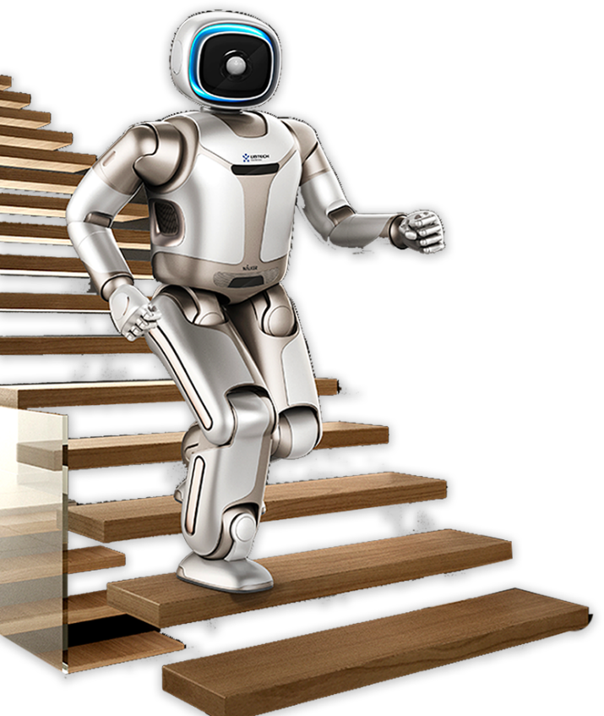
Today’s Personal Robots

Slide 5
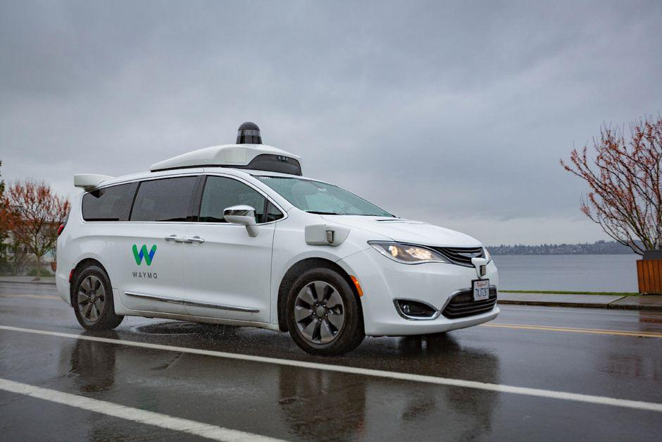
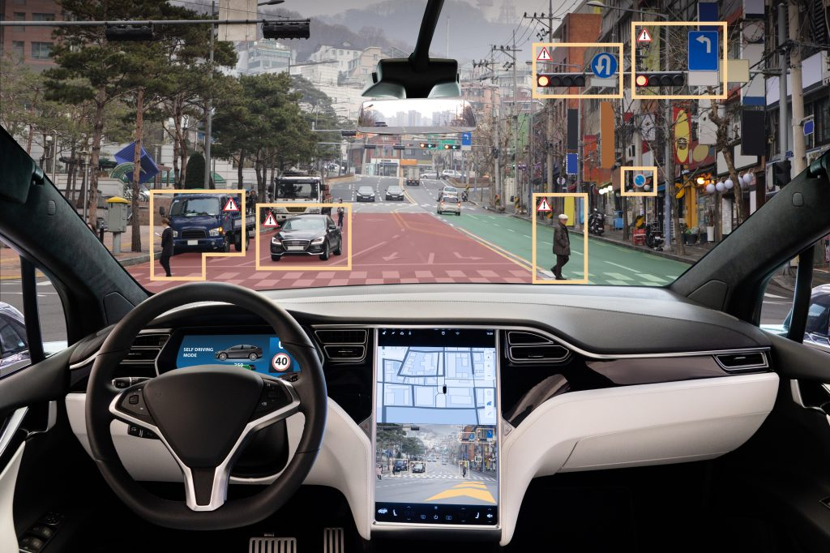
Self-driving Cars
The self-driving cars available today are still not up to the mark. They work fine in empty roads with different turns and traffic lights, but they start to struggle in a real world scenario.
Drawbacks:
Cannot make decisions in a split second
More accidents are happening since self driving cars cannot completely handle real situation where cars suddenly stop or someone crosses the road

Slide 6
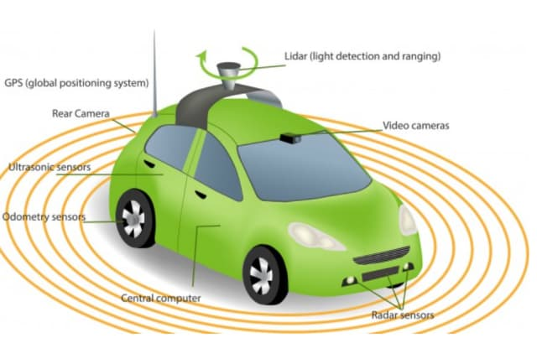
Self-driving Cars
Primary Sensors:
Camera: placed on every side of the car to create a 360 degree view of the environment and also detect objects.
Radar: Supplement camera visions in times of low visibility like night driving and improve detection
LIDAR: helps to have a 3D view of the environment by providing shape and depths to surrounding cars, and also works in low-light conditions

Slide 7

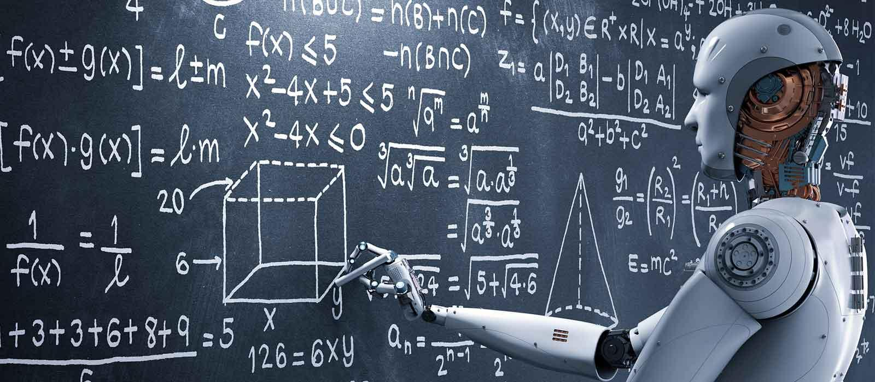
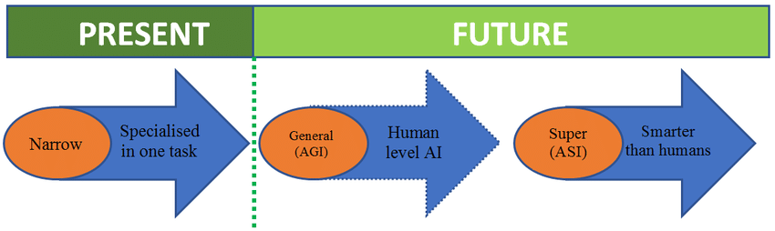
AGI and ASI

Slide 8
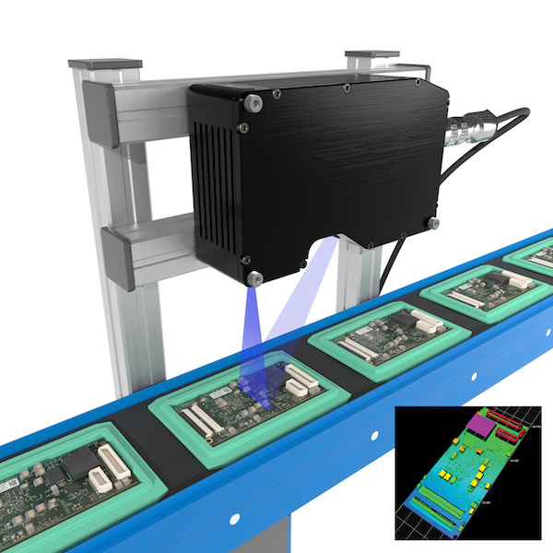
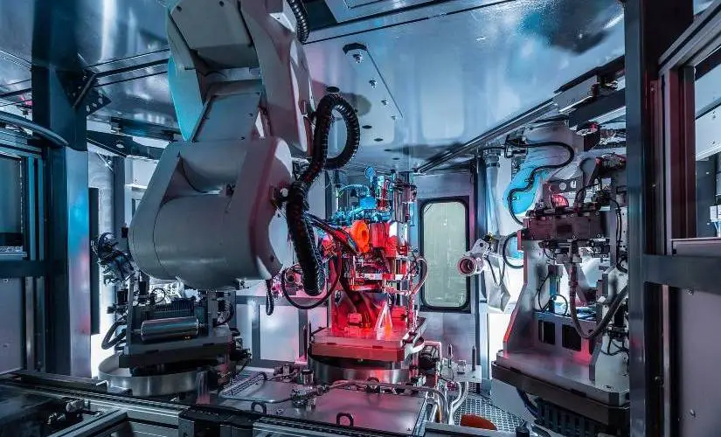
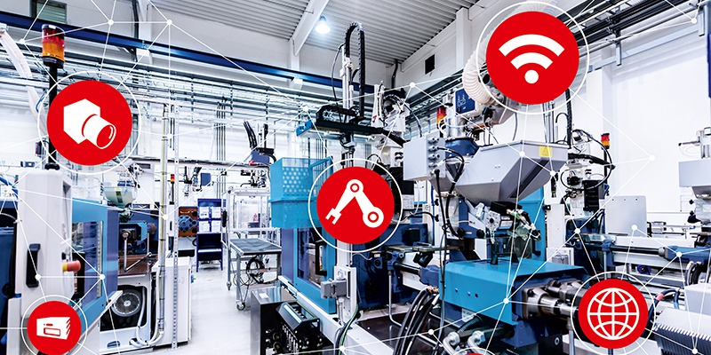
Machine Vision

Slide 9
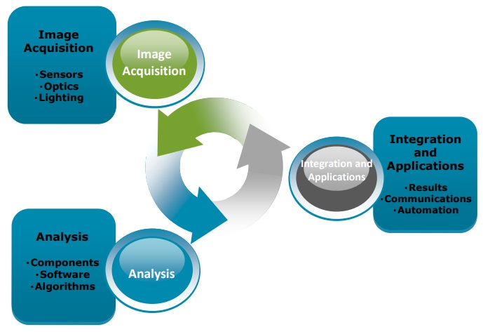
What is Machine Vision(MV)?
The process of extracting information from visual sensors to enable machines to make intelligent decision.
Components of MV
Light source-LED, Fluorescent, Halogen lamps
Lens – Telecentric , Macro lens
Sensors – Optic ,Magnetic type
Vision processing unit
Communication unit
Fig. : Concept of machine vision

Slide 10
Working Principle of MV
Step 1: A camera takes a picture of the object to be tested in the presence of lens with suitable intensity of light source, and sends it to a computer for image processing.
Step 2: The computer will define and analysis the characteristics of images/visual data and make a decision on image analysis.
Step 3: After analysis the computer system will communicate with rejection unit if any defects in the part, or else if it is defect free it will send to the next station for processing.

Slide 11
Machine Vision vs Computer Vision
A machine vision system uses a camera to view an image, computer vision algorithms then process and interpret the image, before instructing other components in the system to act upon that data.
Computer vision can be used alone, without needing to be part of a larger machine system.

Slide 12
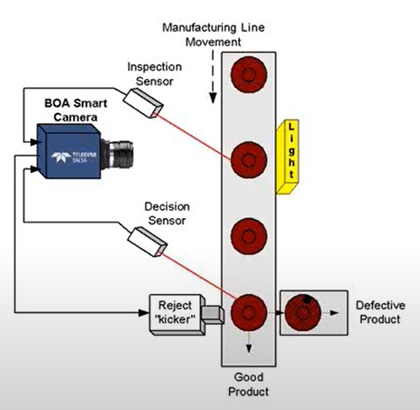
What is Machine Vision Inspection Technology?
Machine vision inspection technology improves your facility’s quality control processes by utilizing cameras with image processing software to inspect parts for flaws or potential defects.
When you invest in machine vision inspection technology for your facility, you will have fewer mistakes reaching your customers, and you can free up your engineers for more critical tasks or projects.
Now that you know what machine vision inspection technology is, let’s dive deeper into how it works.
How Does It Work?
A complete machine vision inspection system has two key components:
A camera that is equipped with a sensor to take photos for inspection.
A processing engine to analyze the photos.
After the camera takes a photo, the processing engine analyzes the information collected and communicates the results.
Machine Vision Inspection Technology
Machine vision inspection technology improves your facility’s quality control processes by utilizing cameras with image processing software to inspect parts for flaws or potential defects.
When you invest in machine vision inspection technology for your facility, you will have fewer mistakes reaching your customers, and you can free up your engineers for more critical tasks or projects.
Now that you know what machine vision inspection technology is, let’s dive deeper into how it works.

Slide 13
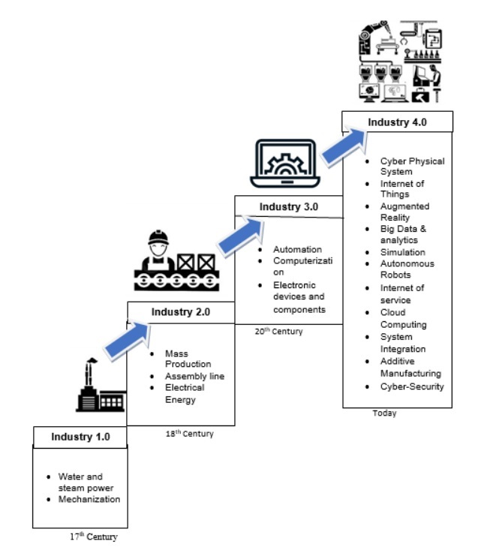
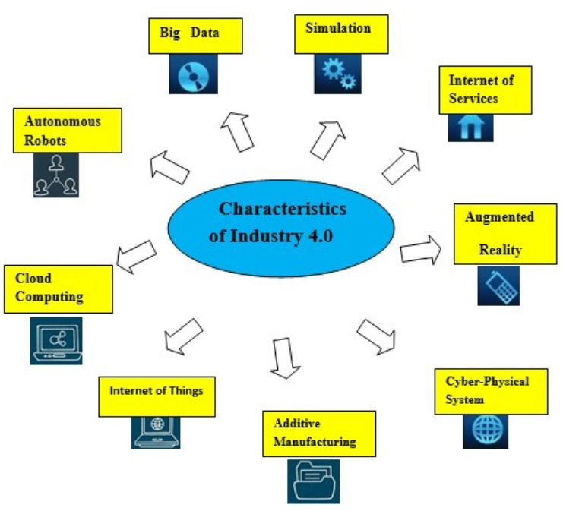
MV is a Key of Fourth Industrial Revolution: Industry 4.0

Slide 14
Application of MV
Application Fields of Machine Vision
Automotive
Electronics
Food
Logistics
Manufacturing
Robotics
Packaging
Pharmaceutical
Mining

Slide 15
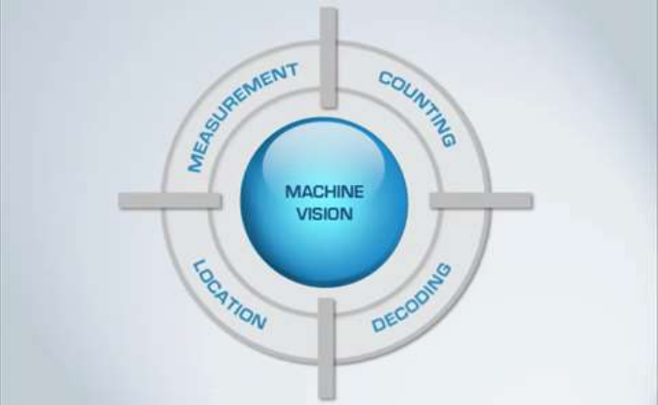
Applications of Machine Vision System
Measurement
Counting
Location
Decoding
so on

Slide 16
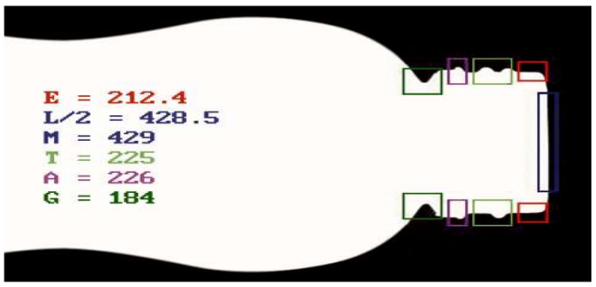
Applications of Machine Vision System
Measurement:
In measurement applications the purpose of the vision system is to measure physical dimensions of the object.
Examples of physical dimensions are distance, diameter, curvature, area, height, and volume.
Example: A camera measures multiple diameters of a bottleneck

Slide 17
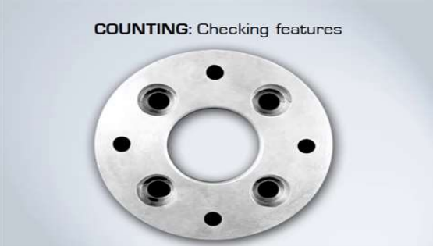
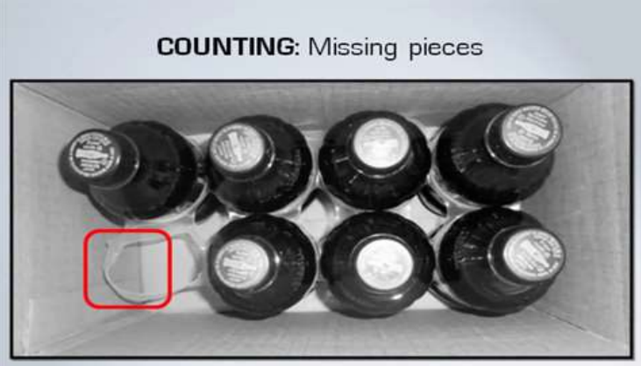
Applications of Machine Vision System
Counting:
Counting is another typical machine vision application
Basically counting means look for number of parts over number of features on a part, this allows us to locate missing part and ensure the products are assembled properly.
Example 1: counting of holes on the aluminium flange
Example 2: Identifying the presence or absence of the part.
Example 1
Example 2

Slide 18
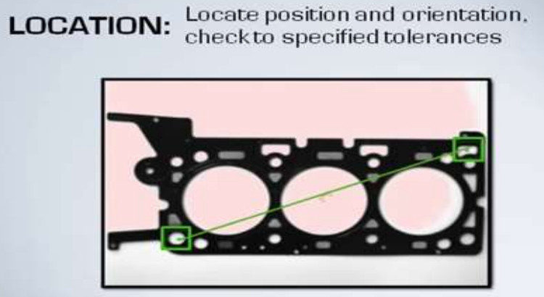
Applications of Machine Vision System
Location:
Machine vision also used to report the location and orientation of the parts.

Slide 19

Applications of Machine Vision System
Decoding
It is an identification application in which the vision system reads various codes and alphanumeric characters (text and numbers) and decodes the codes to get the product features .
It is used to record information as historical data, track products, validate data, verify correctness of data and verify the product.

Slide 20
Advantages of Machine Vision
Machine vision system works faster than manual system.
Machine vision is consistent.
Perform beyond human vision
High repeatable in controlled environment
No fatigue – 24/7
Reliable
Good for unsafe and hazardous environment
Operate well in space constrained environments

Slide 21

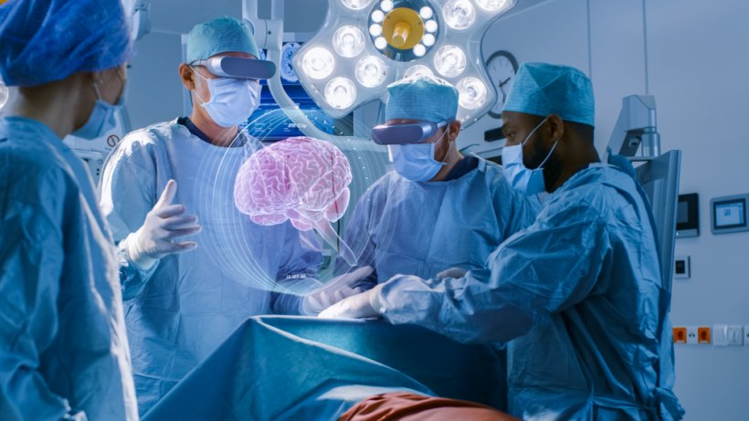
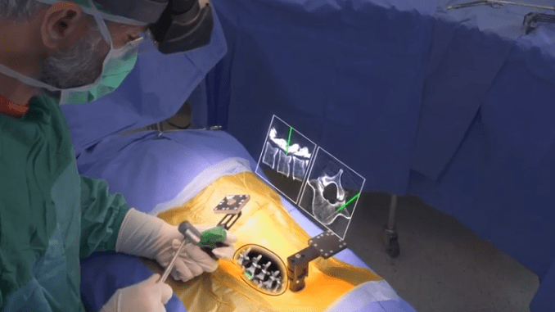
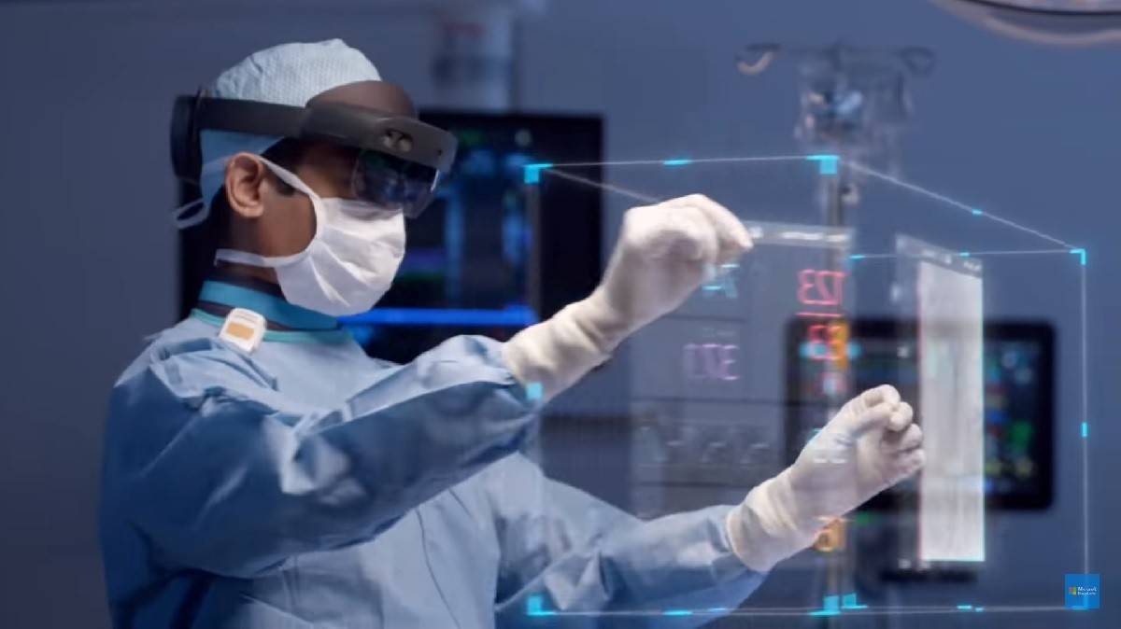
AR in Surgery & Healthcare

Slide 22
Augmented reality-assisted surgery
Augmented reality-assisted surgery (ARAS) is a surgical tool utilizing technology that superimposes a computer-generated image on a surgeon’s view of the operative field, thus providing a composite view for the surgeon of the patient with a computer generated overlay enhancing the operative experience.
It can be used for training, preparation for an operation, or performance of an operation. ARAS can be performed using a wide array of technology, including an optical head-mounted display (OHMD)—such as the Google Glass or Microsoft HoloLens a digital overlay from robotic and laparoscopic surgery feeds.
The technique has been primarily been tested in i) the urological and ii) cardiovascular domains.

Slide 23
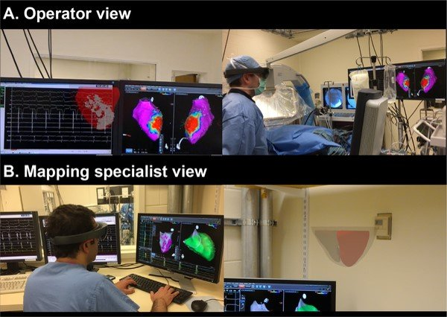
Augmented reality-assisted surgery
AR may assist cardiologists perform complex procedures
The OR-Bot’s all-digital system offers three unique visualization options depending on the surgeon’s preference: the first is the all-new ORLenz augmented reality surgery headset featuring:
a surgery view with augmented virtual patient and operating tool information;
the choice of using a autostereoscopic “3D glasses-free” 3D 8K display monitor positioned directly in front of the surgeon;
viewing the surgery through a microscope-like virtual reality viewing station positioned on one of the OR-Bot’s robotic arms.

Slide 24
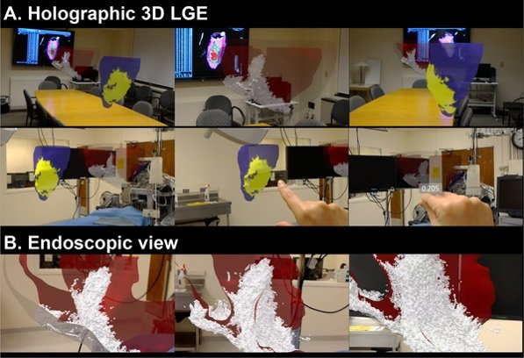
Augmented reality-assisted surgery
AR may assist cardiologists perform complex procedures
3D holographic visualization of the scar was performed to assist assessment of the complex 3D scar architecture.
An operator and mapping specialist viewed the holographic 3D scar during electrophysiological study, and completed the perceived usefulness questionnaire in the six-item usefulness scale and found it useful to have scar information during the intervention.
The user could interactively explore 3D myocardial scar in the augmented reality environment that allows for the combination of holographic 3D LGE data interacting with any real-world environments, such as a surgical suite or patient’s body.
Demonstration of the 3D holographic visualization of the voxel-wise 3D scar rendering and scar projected endocardial surface mesh from 3D LGE data. Source: PLOS ONE

Slide 25
Augmented reality-assisted surgery
Augmedics Launches First AR Spine Surgery Guidance System
Allows surgeons to visualize anatomy in real-time—as if they have “x-ray vision”—and accurately guide their instruments and implants.
So, xvision Spine elable accurately navigating instruments and implants while looking directly at the patient, rather than a remote screen.

Slide 26
Augmented reality Assisted Surgery (Microsoft-Phillips)
By using HoloLens 2 Augmented Reality can help a doctor and a surgical team in the operating room.
Microsoft Augmented reality is slowly, but definitely, entering the Operating Rooms in many hospitals around the world to help the surgeons and the operating team.
Augmented Reality in the Operating Room

Slide 27
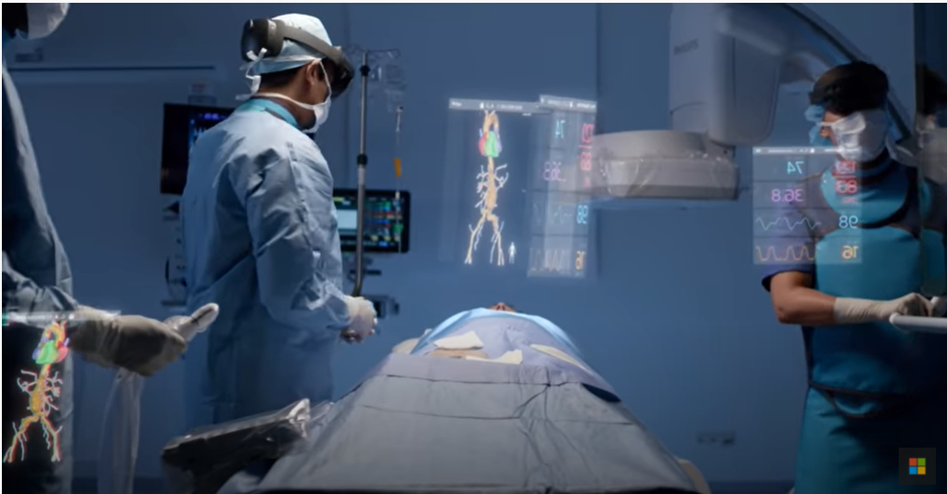
Augmented reality Therapy (Microsoft-Phillips)
Philips, a major player in the provisioning of advanced equipment in the operating rooms, has teamed up with Microsoft to use their Hololens 2 technology (watch the clip) to assist, actually augment, surgeons in the OR.
Hololens 2 supports multiple interactions, gesture recognition, voice control, eye tracking, thus letting the surgeons’ hands free. Interestingly, Hololens 2 software support cooperative working by letting each component in the team to see the same image.

Slide 28
Augmented reality-assisted surgery
Limitations:
The absolute role and indications for AR in surgery are yet to be established.
The data so far generated in AR are not substantial.
a universal problem for any surgeon in the AR environment is that the organ of interest does not behave as expected.
Human organs are not rigid, but deform according to the rhythms of the heartbeat and respiration, according to pressure during laparoscopic insufflation

Slide 29
Introduction to IoT

Slide 30
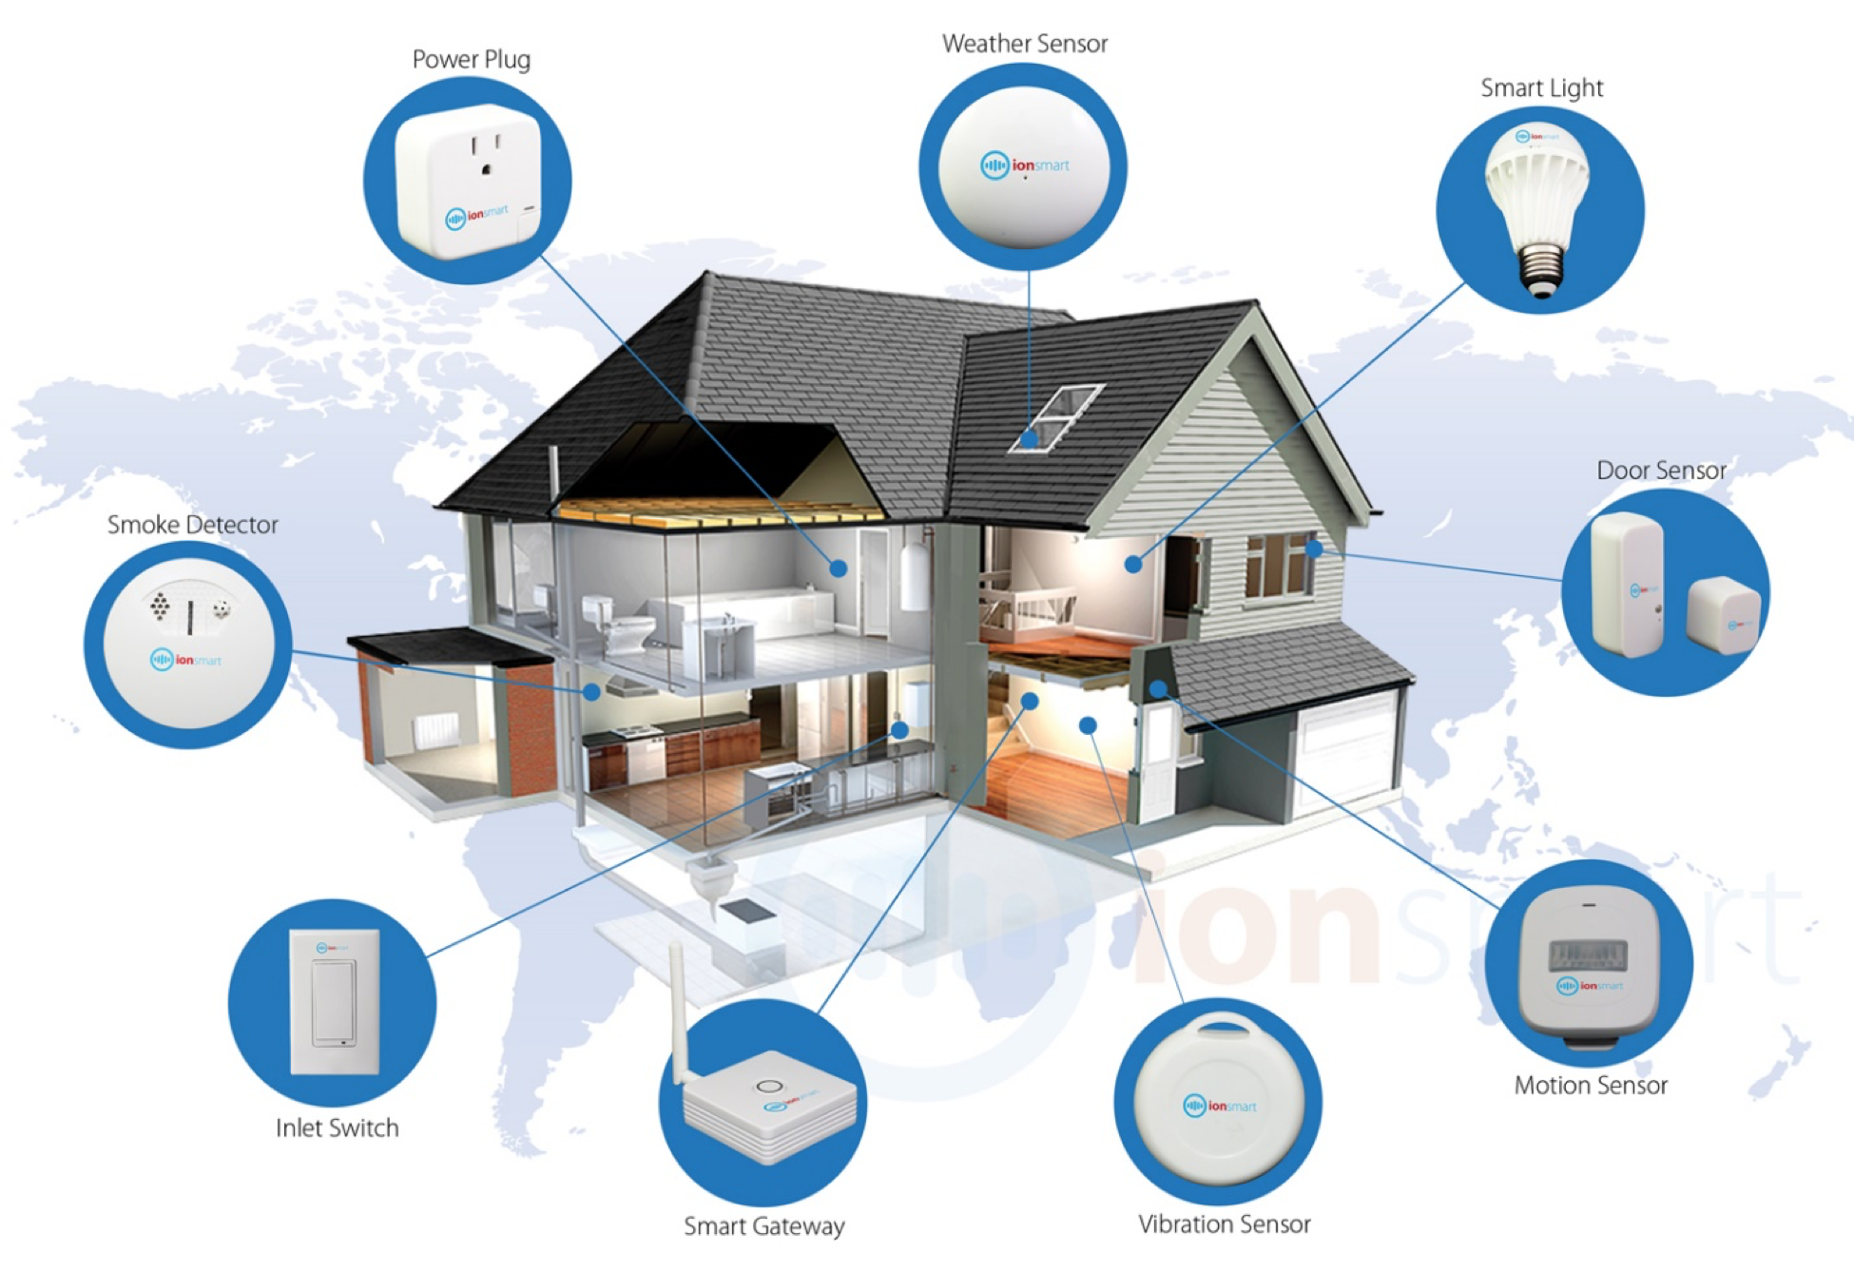
What is IoT

Slide 31
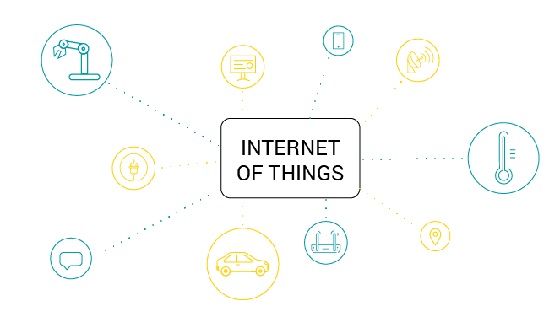
Evolution of IoT
Pre-Internet
Internet of Content
Internet of Services
Internet of People
Internet of Things
Human to Human
Fixed Line Telephones
WWW
E-mail
Web 2.0
E-commerce
Social Media
YouTube
Machine to Machine
Automation

Slide 32
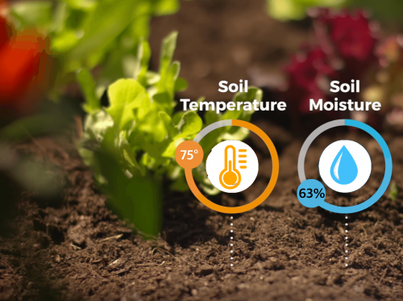
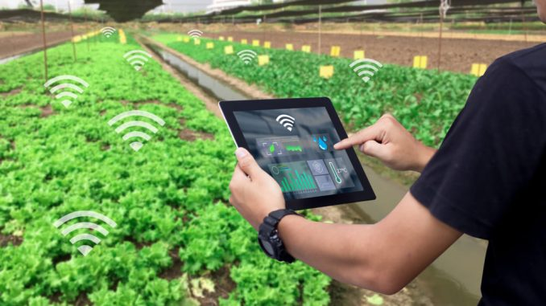
Example (1)
Plants need watering in humid days.

Slide 33
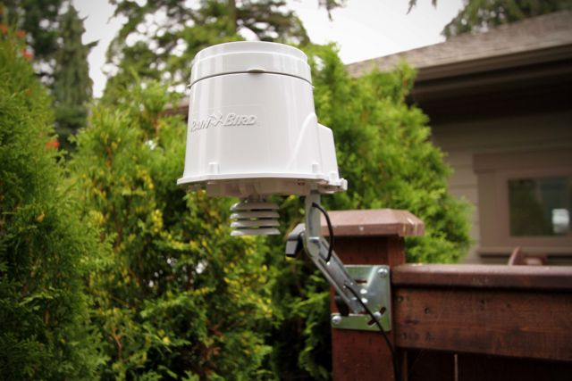
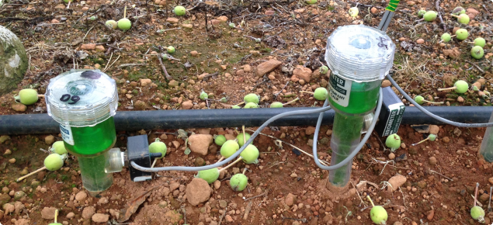
Example (2)
Different sensors will sense if humidity is above a certain value and send it to
the cloud
Figure: Rainbird ESP-SMT Smart
Irrigation Controller.
Figure: Tensiometer Sensor.

Slide 34
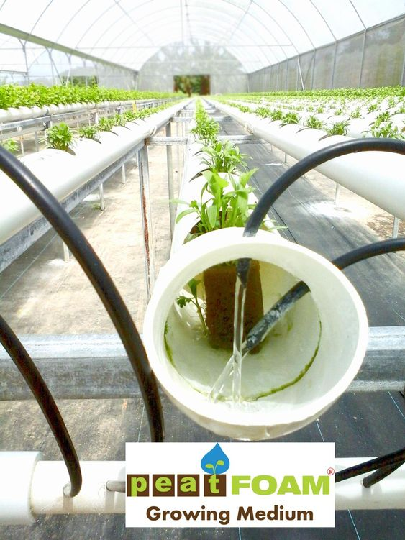
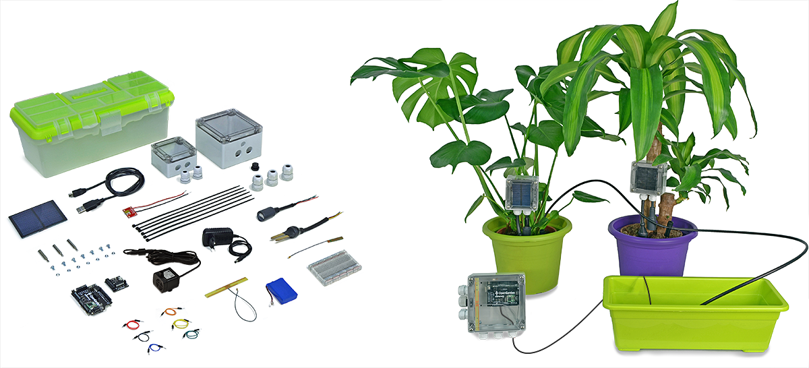
Example (3)
After processing, a signal will be sent to actuator to start watering the plants.

Slide 35







Advantages and Disadvantages
Advantages
Disadvantages
Communication
1
Compatibility
Automation and control
2
Complexity
Saves time
3
Privacy
Increases efficiency
4
Unemployment

Slide 36
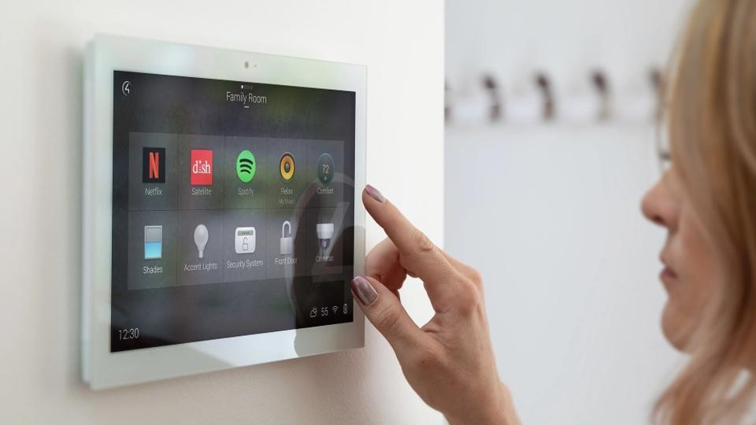
Home Automation

Slide 37

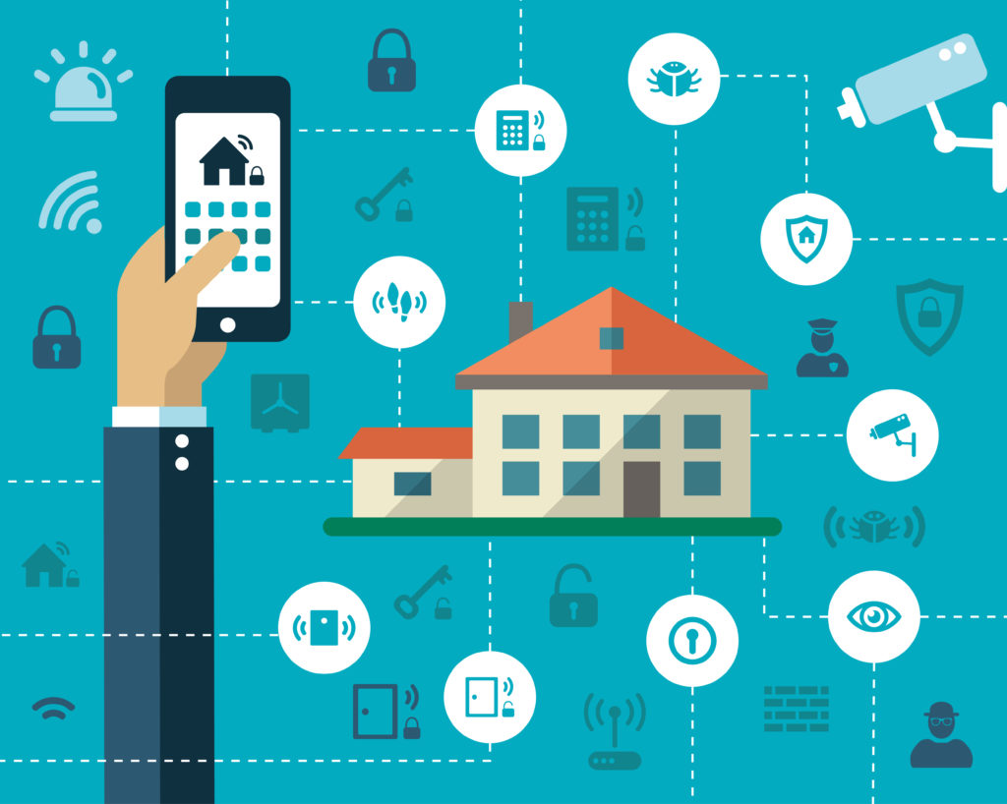
IoT and Smart Homes
.IOT- The interconnection via the Internet of devices (sensors, controllers, actuators, buses and interaction system) embedded in everyday objects, enabling them to send and receive data.
Smart Home- It is an Internet of Things (IoT) application that utilizes the Internet to monitor and control appliances using a home automation system.

Slide 38
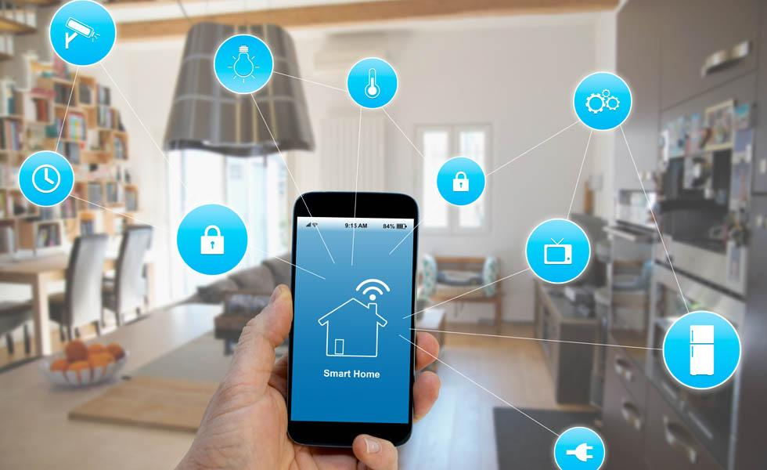
What is a Smart Home ?
A smart home provides comfort, security and energy efficiency to its owners, regardless of whether anyone is home.
Home Appliances remotely controlled
The Appliances can send you notifications and updates
Appliances can talk to each other

Slide 39

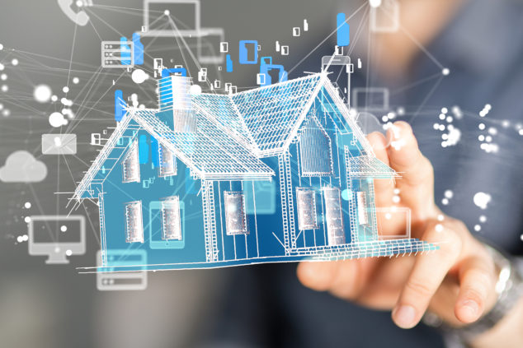
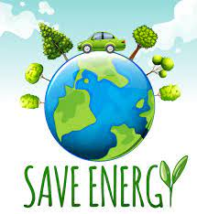



What makes them better ?
Provides comfort
Reduce energy consumption
Cost savings
Provides better security and monitoring
Saves time

Slide 40
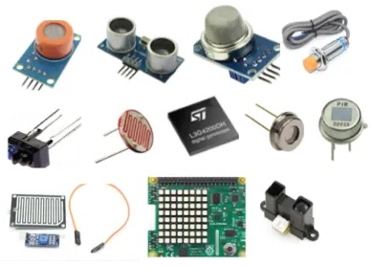
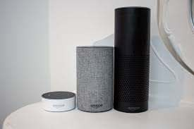
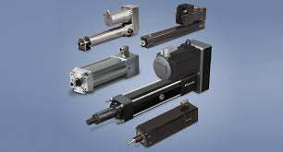

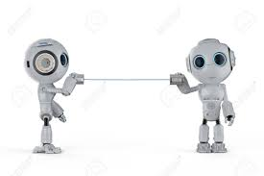
How do they work?
Sensors
Measures or detects changes in the environment and sends the information to other electronics
Controllers
Voice or remote control devices such as Smartphone or virtual assistant devices
Actuators
A component which moves or controls a mechanism like light switches
Buses
Wired or wireless connectivity
Interfaces
Machine-Machine or Human-Machine Interaction

Slide 41
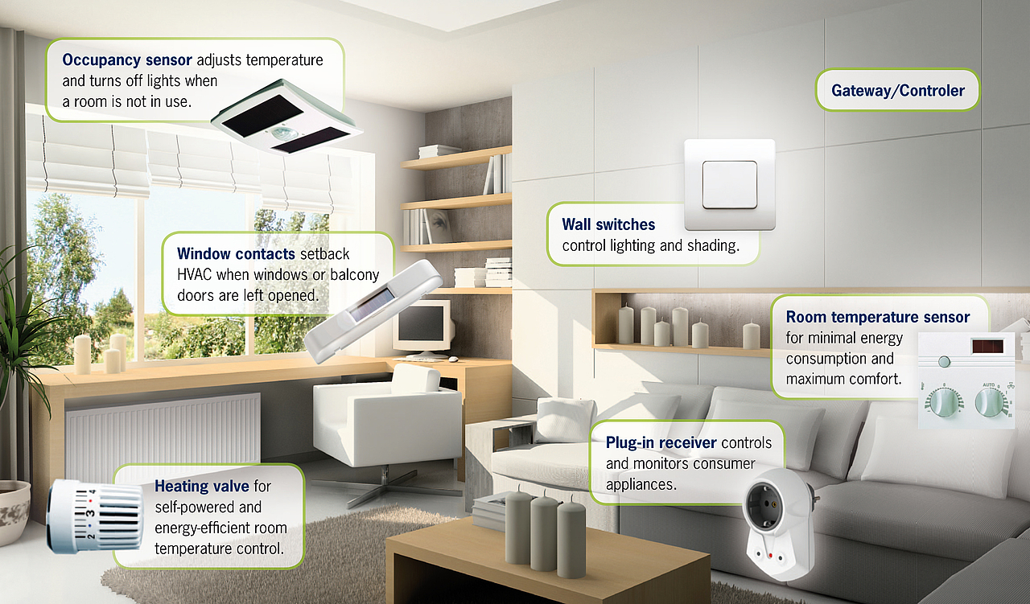
What does a smart home need (1)
Sensors

Slide 42
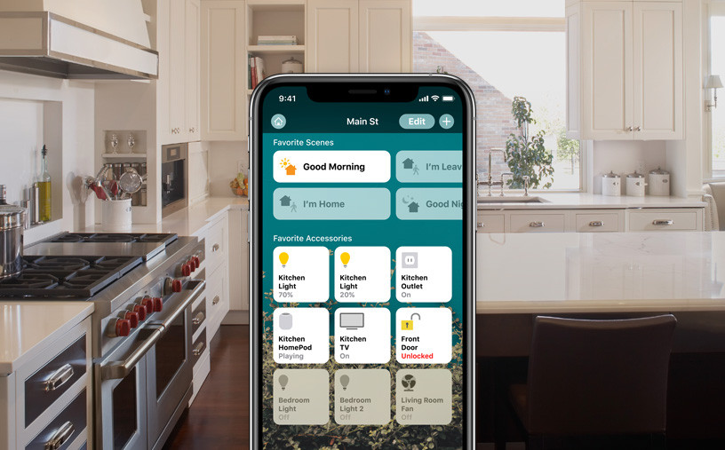
What does a smart home need (2)
Interfaces

Slide 43

What does a smart home need (3)
Internet (wired or wireless)

Slide 44
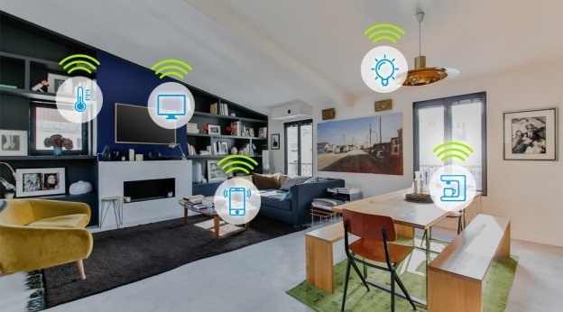
What does a smart home need (4)
Actuators

Slide 45

What does a smart home need (5)
Controllers (using touch, voice etc.)

Slide 46
Pros and Cons of Smart Home
Pros
Cons
Saves Energy
1
Expensive
Ease of use
2
Difficult to adapt
Better security and control
3
Laziness

Slide 47

Conclusion
As we know technology is rapidly changing and it is transforming every sectors of our society. Therefore, it is estimated that in the next 10 or 15 years 90% of the homes will come equipped with some form of networking and automation.
The future home is a “Smart Home”

Slide 48

Advancements of Computer Science in Agriculture

Slide 49


Sensors
Different sensors will sense if soil temperature and humidity is above a certain value and send it to the cloud.
After processing, a signal will be sent to actuator to start watering the plants.

Slide 50


Drones
Extremely effective in terms of providing Bird’s Eye View
Can be combined with many sensors and devices
Can monitor and record in real time
Can send out collected data
Can be controlled remotely

Slide 51



Smart Farming
Driverless Tractors
Weed Identifying and Removing Robots
Seeding and Planting Robots

Slide 52


Smart Farming (Continued)
Autonomous Farms
Fully Automated
Human Labor not Needed
Artificial Lighting
Providing best condition for growth
artificially

Slide 53

Future of CS in Agriculture can bring revolutionary changes!

Slide 54

Industrial automation
Industrial automation refers to the use of intelligent machines in factories so that manufacturing processes can be carried out with minimal human supervision
Benefits
Improved quality
Precision, flexible and fast paced
High productivity
Higher efficiency and throughput
Lower costs
Improved Speed to Market
Better Safety
No fatigue or distractions

Slide 55

Types of industrial automation
Fixed automation: Automated production facility where the sequence of processing or operations are fixed by the equipment configuration
Product specialization for one product style
Precision and high production rate
Fixed hardware components
Difficult to change one product style to another
Example: Automatic Assembly machine

Slide 56

Types of industrial automation
Programmable automation: Automation for producing products in batches by reprogramming the equipments and change them to accommodate new production style
Used to create multiple product styles
Reprogramming of equipments needed to change one product style to another
Time consumed in reprogramming results in loss of production
Production rate is less than fixed automation
Example: Industrial robots, Numerical control machine tools

Slide 57

Types of industrial automation
Flexible automation: An extension of programmable automation process where variety of products produced is sufficiently limited so that the changeover of the equipment can be done very quickly and automatically.
Reprogramming of equipments is done offline at a computer terminal without the use of production equipment itself
Product style can be changed one after another without time loss
More production rate than programmable automation
Example: Robot arms that can be programmed to assume multiple tasks (insert screw, drill holes, sand, wield etc) on an assembly line

Slide 58

Types of industrial automation
Integrated automation: Includes the total manufacturing system into a computer controlled, digitally processed and coordinated system.
Industrial and non-industrial processes and robot integration are handled by a central automation control point
Used in computer integrated manufacturing and several advanced process automation system
Example: Computer controlled system and Production line control process

Slide 59

Implementation of industrial automation
Pharmaceutical companies
Lesser space utilization
Reduction of production downtime
No labour turnovers
Enhanced health and safety
Better waste management system
Increased production flexibility
Improved quality and output for production
Lower operating costs

Slide 60

Implementation of industrial automation
Flexible manufacturing system
Easily adapt to changes in the type and quantity of the product being manufactured
Improved efficiency
Lower production costs

Slide 61

Future of industrial automation
Fully automated factories
Nanotech, complex adaptive systems, and most wireless systems will be common in the future.
Efficient utilization of energy, raw material and human resources
Multi-functional robots associated with human workers
More job opportunities

Slide 62

Financial Technology (Fintech)
Fintech includes new technology to improve and automate the usage and delivery of financial services.
Implementation of fintech can be seen in education, retail banking, investment management, fund-raising etc

Slide 63

Cryptocurrency (Bitcoins)
Digital or virtual currency secured by cryptography
Exists outside government control and central authorities
Uses various encryption algorithms and safeguards the currency exchange networks.
Not limited to a single country
Does not require any bank accounts
Easy to trade with minimum processing fee
Allows illegal activities like money laundering and tax evasion since it cannot be traced officially
Value of cryptocurrency can collapse or fluctuate at a large rate
Most popular cryptocurrency: Bitcoins

Slide 64

Fintech in Bangladesh
Non-banking fintech services have become the market leaders in Bangladesh

Slide 65

Fintech is the future
Reform the payment processing activities within the economy
Reduce the amount of cash required for printing and distribution of currency
Automate the traditional financial activities
Reach customers and grab the market largely by targeting young population since they can adapt to technology faster and potentially become avid users of fintech

Slide 66






Techfin
Techfin is how the leading technological companies expand their business into the financial services.
The technological firms that has been delivering technology solutions try to launch new ways of providing financial services

Slide 67

Techfin
Familiarity and addiction of the platforms
Appropriate and responsive experience for the customers
Better understanding of consumer behaviors

Slide 68

Conclusion
Massive technological advancements
Artificial Intelligence
Machine Vision and Augmented reality
Autonomous vehicle
IoT and Smart home appliances
Agricultural Usage
Automations and robotics
Digital currency
And many more…

